Slide 1





Mini-game collection
Geun Woo Kim
GAME START!

Slide 2







How to play?
It consists of four games in total
Break game If you swipe the ball and shoot it, the ball flies in that direction and breaks the bricks
Avoid game The game where you get points by damaging the dungs from the top to the bottom in the left and right directions
2048 Using the keyboard arrow keys, all blocks move in that direction, but if there is the same number, it is combined. A game of repeating this to make the number 2048 (the first number starts with two 2 or four)
Escape game A game to kill monsters and get a treasure chest to escape from Dungeon (it consists of 1 to 3 stages, and the size of the map and the number of monsters are different for each stage)

Slide 3


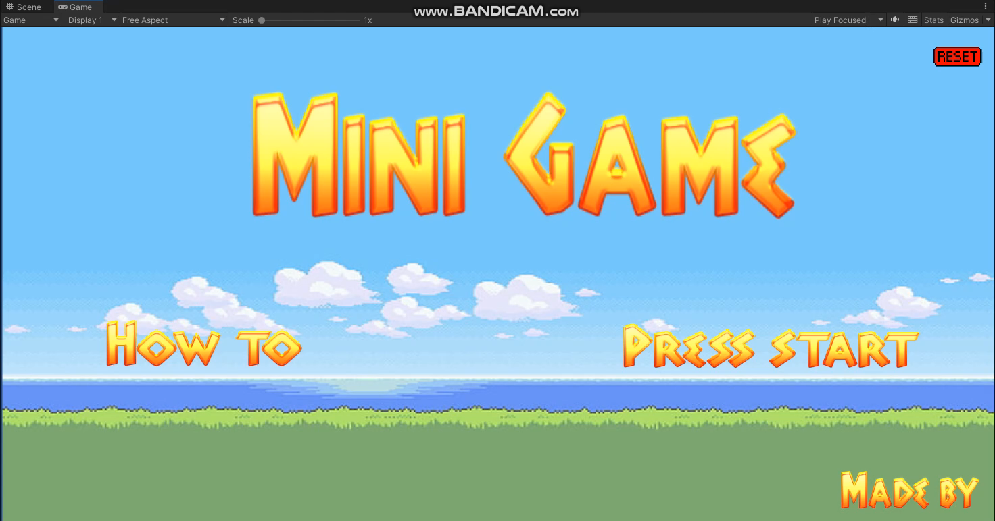
Chapter 01
Initial Screen Play Video
Game main screen, game description, game selection screen, creator, back to main screen (Click the red Reset button in the upper right corner of all games to return to main screen)

Slide 4
Chapter 01
Initial Screen Play Video
Main Screen -> Select Made By

Slide 5
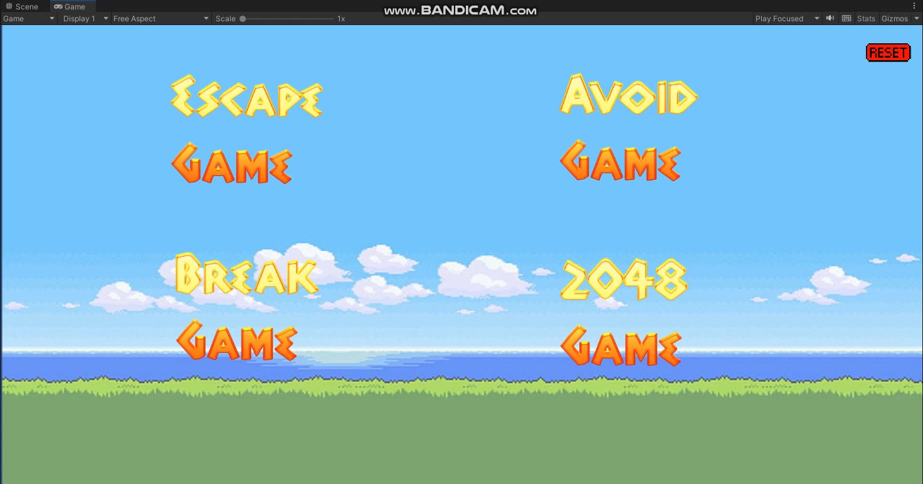
Chapter 02
Description of Escape Game Play Video and Code
Game Selection Screen -> Select Escape Game

Slide 6
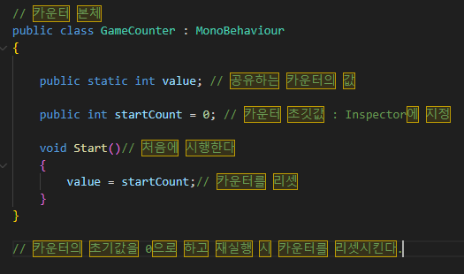
Chapter 02
Description of Escape Game Play Video and Code
Counter code to record a score on the Canvas screen

Slide 7
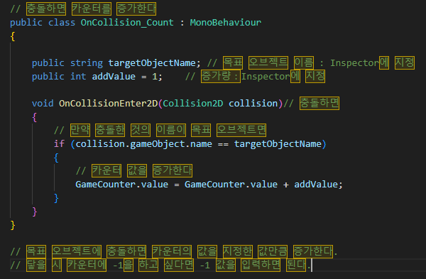





Chapter 02
Description of Escape Game Play Video and Code
Appearing monsters (five in total) and Counter increment code in case of collision
When a player collides with a monster Depending on the monster, -1 or -3 points Increasing on the counter

Slide 8
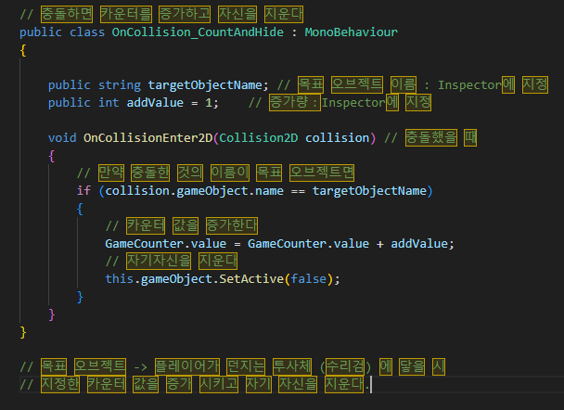

Chapter 02
Description of Escape Game Play Video and Code
After increasing the counter in the event of a collision Delete yourself (monster)
A projectile fired by a player Delete Monster after +1 or +3 points increase on the counter when colliding with Monster

Slide 9
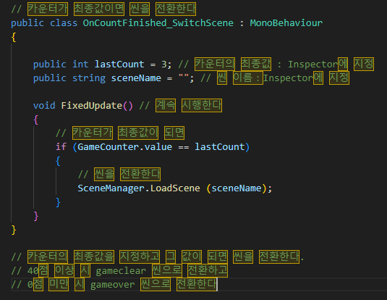
Chapter 02
Description of Escape Game Play Video and Code
When the counter (Score) is satisfied Code to switch scenes

Slide 10
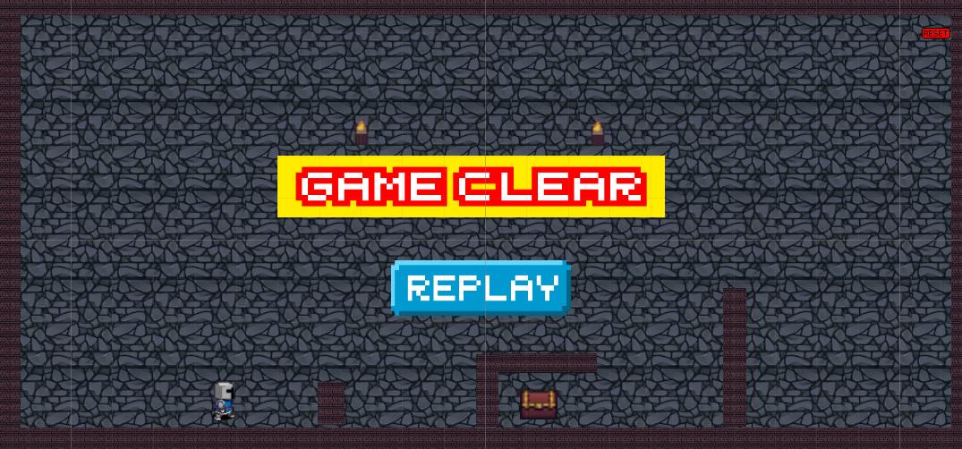
Chapter 02
Description of Escape Game Play Video and Code
Game clear screen when the counter is 40 points or higher

Slide 11
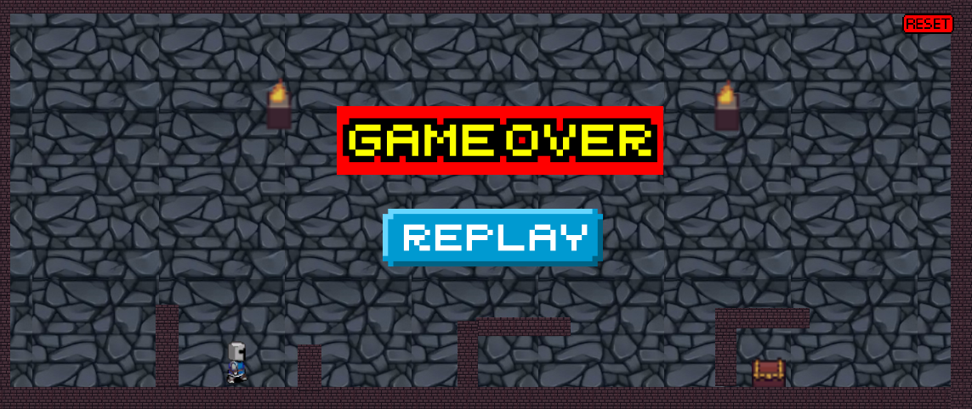
Chapter 02
Description of Escape Game Play Video and Code
Game over screen when counter (Score) is less than 0 points

Slide 12
Chapter 03
avoid game Play video and code description
Game Selection Screen -> Select Avoid Game

Slide 13
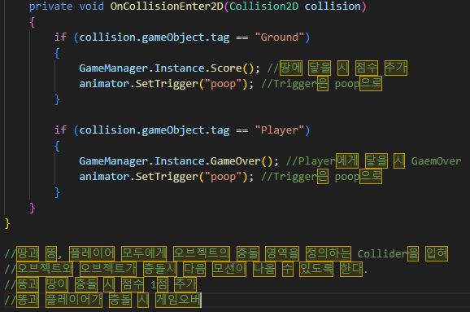
Chapter 03
avoid game Play video and code description
When the poop hits the ground, one point is added to the score box, Game over when the poop hits the player

Slide 14
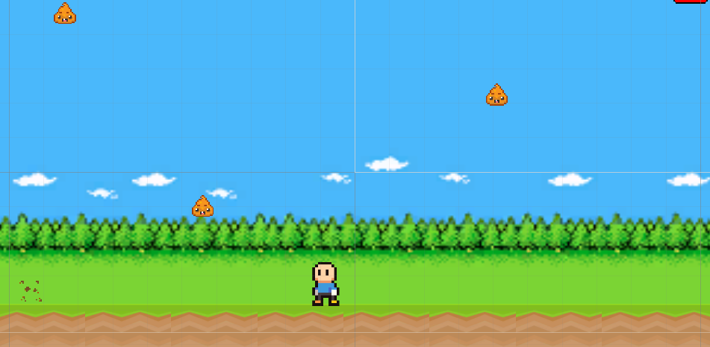
Chapter 03
avoid game Play video and code description
When the poop hits the ground, the motion of the poop popping comes out and is added one point to the score compartment

Slide 15
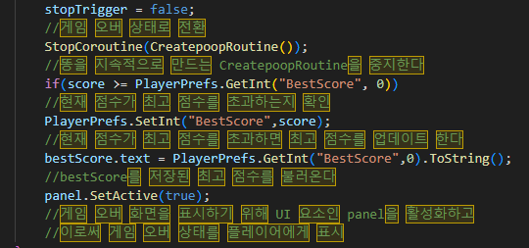
Chapter 03
avoid game Play video and code description
BestScore and Gameover codes where the poop hits the player

Slide 16
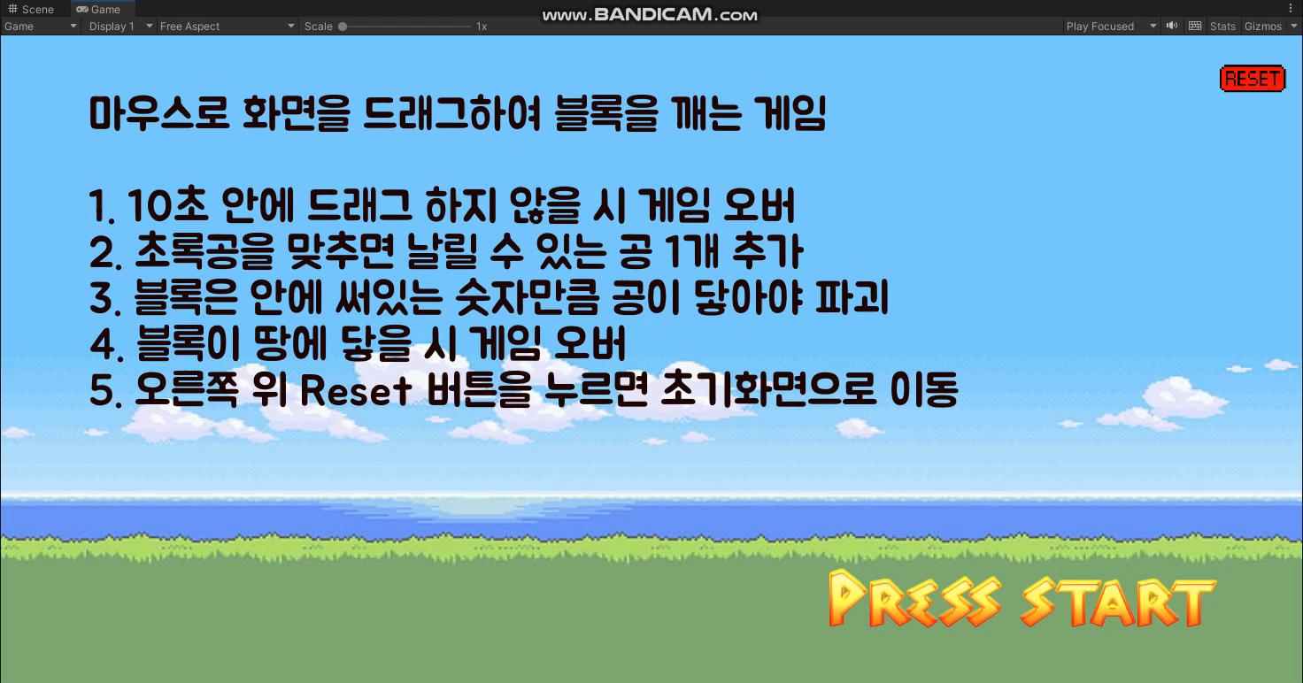
Chapter 04
Break game Play video
If you don't drag for 10 seconds in the Break game Switch to the Gameover scene when there is no movement on the screen (Press Regame to switch back to the Break Game scene)

Slide 17
Chapter 05
2048 game Play video
Game Selection Screen -> 2048 Game Selection (2048 game explanation scene added)

Slide 18
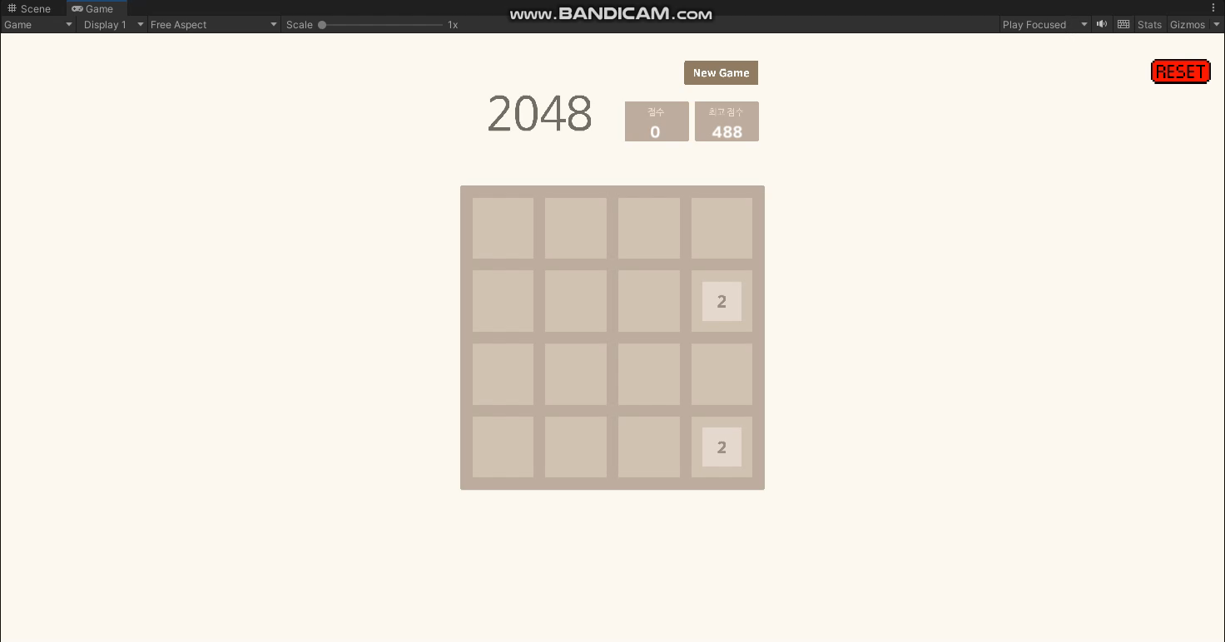
Chapter 05
2048 game Play video
If you don't drag for 10 seconds in 2048 games Switch to the Gameover scene when there is no movement on the screen (Turn back to the 2048 game scene when pressing Regame)

Slide 19
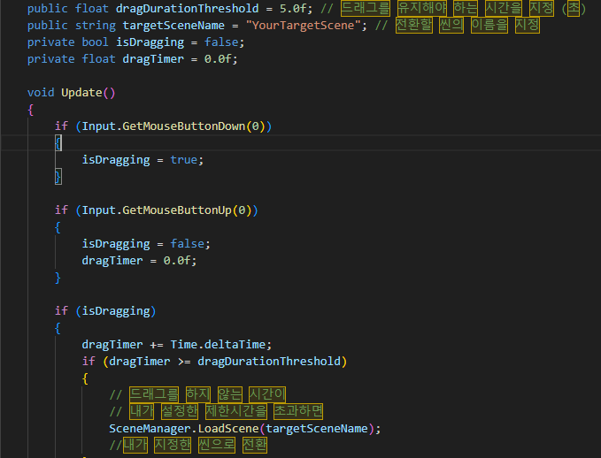
Chapter 06
Break game, 2048 game Additional Code Description
When you don't drag for 10 seconds Code to switch to Gameover scene

Slide 20
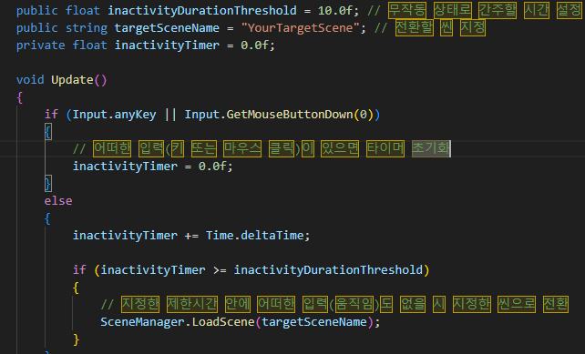
Chapter 06
Break game, 2048 game Additional Code Description
When there's no movement on the screen for 10 seconds Switch to Gameover Scene

Slide 21

Thank you!
GAME over!!

